Slide 1

MALAVIYA NATIONAL INSTITUTE OF TECHNOLOGY, JAIPUR
ONLINE TRAINING & PLACEMENT MANAGEMENT SYSTEM
PRESENTATION BY:
ASHISH GOYAL
ABHISHEK TIBREWAL

Slide 2
CONTENT:
Planning and Requirement analysis
Drawbacks in existing systems
User Requirements(features)
Data gathering
Design
Use-Case Diagram
E-R Diagram
Relational Schemas
Normalization of relational schemas
Implementation
Coding
Glimpse of our site
Tools and technologies used
References

Slide 3
PLANNING AND REQUIREMENT ANALYSIS

Slide 4
Drawbacks in existing systems
Some problems with existing systems :
Student has no profile of its own to see.
Student can’t update his/her information by himself/herself, he/she has to go to Placement & Training Cell office and the updation is done manually.
No confirmation mail sent to student if he/she got selected by any company.
There is no separate notification panel. All the information comes through mail, so anyone can’t see all the information at one place.
The maximum work of admin is manual.

Slide 5
User Requirements(Features)
For the student:
Student can register at training and placement cell.
Can login and view his/her profile.
Can update his/her information that were provided at the time of registration.
Student can view general notifications from T & P cell and can also see the details of companies that are visiting.
A student can apply for the visiting company for internship or placement if he/she is eligible for that.

Slide 6
For the company:
A company can register at training and placement cell.
Company add basic details like, for which branch the company is coming and criteria for that branch.
E-mail:
If student forgets password for login then a new password will be send to his/her e-mail id.
A confirmation mail will be sent to student after he/she got selected in any company.

Slide 7
For the admin:
Can add new admin at training and placement cell.
Add general notifications for the students.
Have access to all the information about students and companies means admin can view or update information of students and company.
Only the admin gives approval to the company after verifying that it’s a correct company or not.
Admin also update the absents of students.
Admin changes the status of the students from not selected to got intern/placement after receiving final result from the company.
Admin can view the list of students who got placement or internship in which company.

Slide 8
Student Notification Panel:
There will be general notifications about interviews, pre-placement talks etc.
List of visiting companies will be there with their details
and basic criteria.
Student can also view the name of companies in which he/she registered.
Admin Notification Panel:
List of all students who got placement.
List of all students who got internship.
List of all registered students for company(separate for internship and placement).

Slide 9
The password of every user is stored in database as encrypted form, so that no one can understand it .
If any user is logged in then no other user can log in at the same time on the same browser.

Slide 10
Data Gathering
The data is gathered from various resources:
Student’s data is collected from the students of our college (MNIT Jaipur).
Student’s images are collected from students through MNIT-ERP and social media.
Company’s information is gathered by the mail received from “Placement & Training Cell, MNIT Jaipur ”.

Slide 11
DESIGN

Slide 12
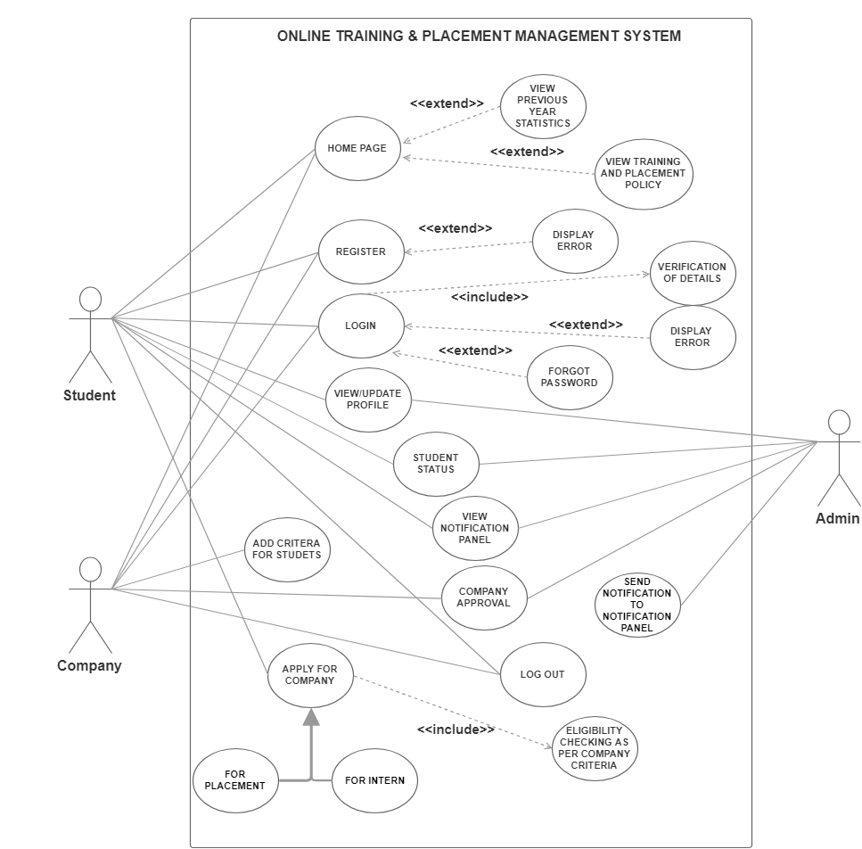
Use Case Diagram

Slide 13
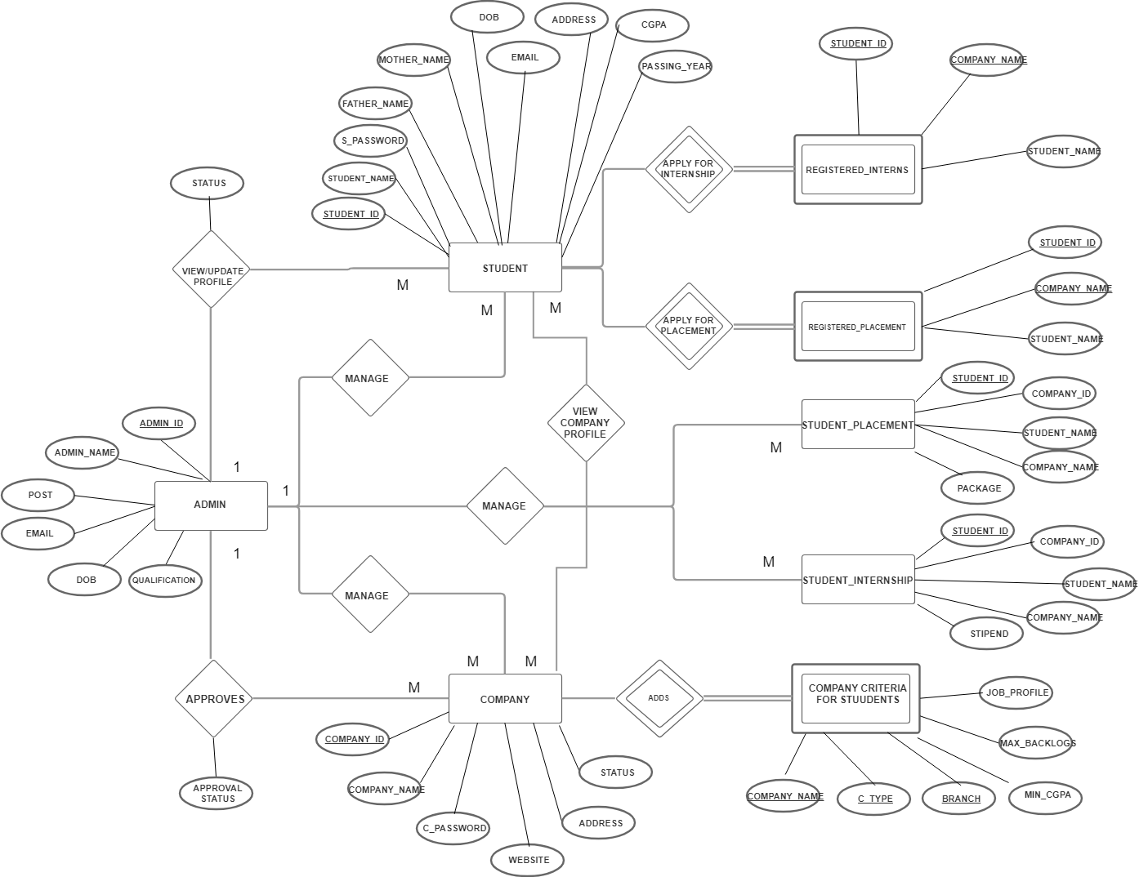
E-R Diagram

Slide 14
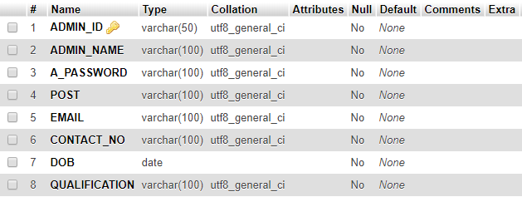
Relational Schemas
Admin Schema

Slide 15
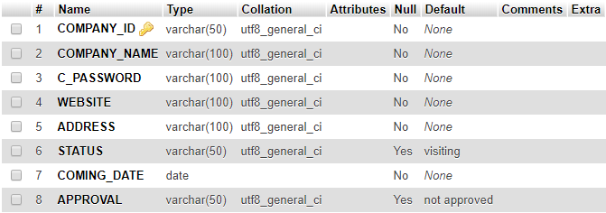
Relational Schemas
Company Schema

Slide 16
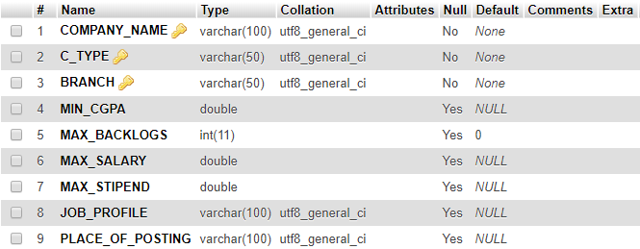
Relational Schemas
Company Criteria Schema

Slide 17
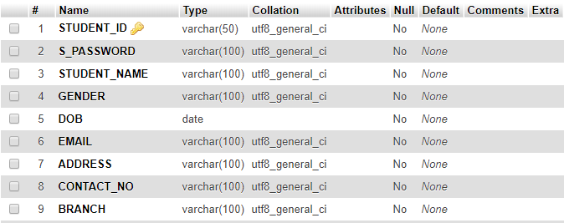
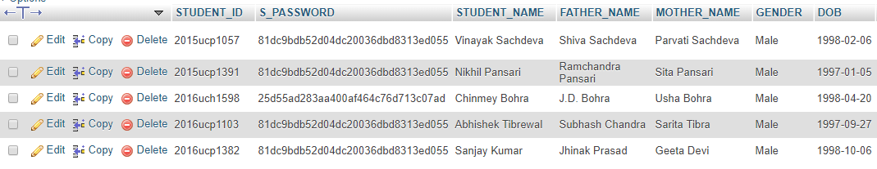
Relational Schemas
Student Schema

Slide 18
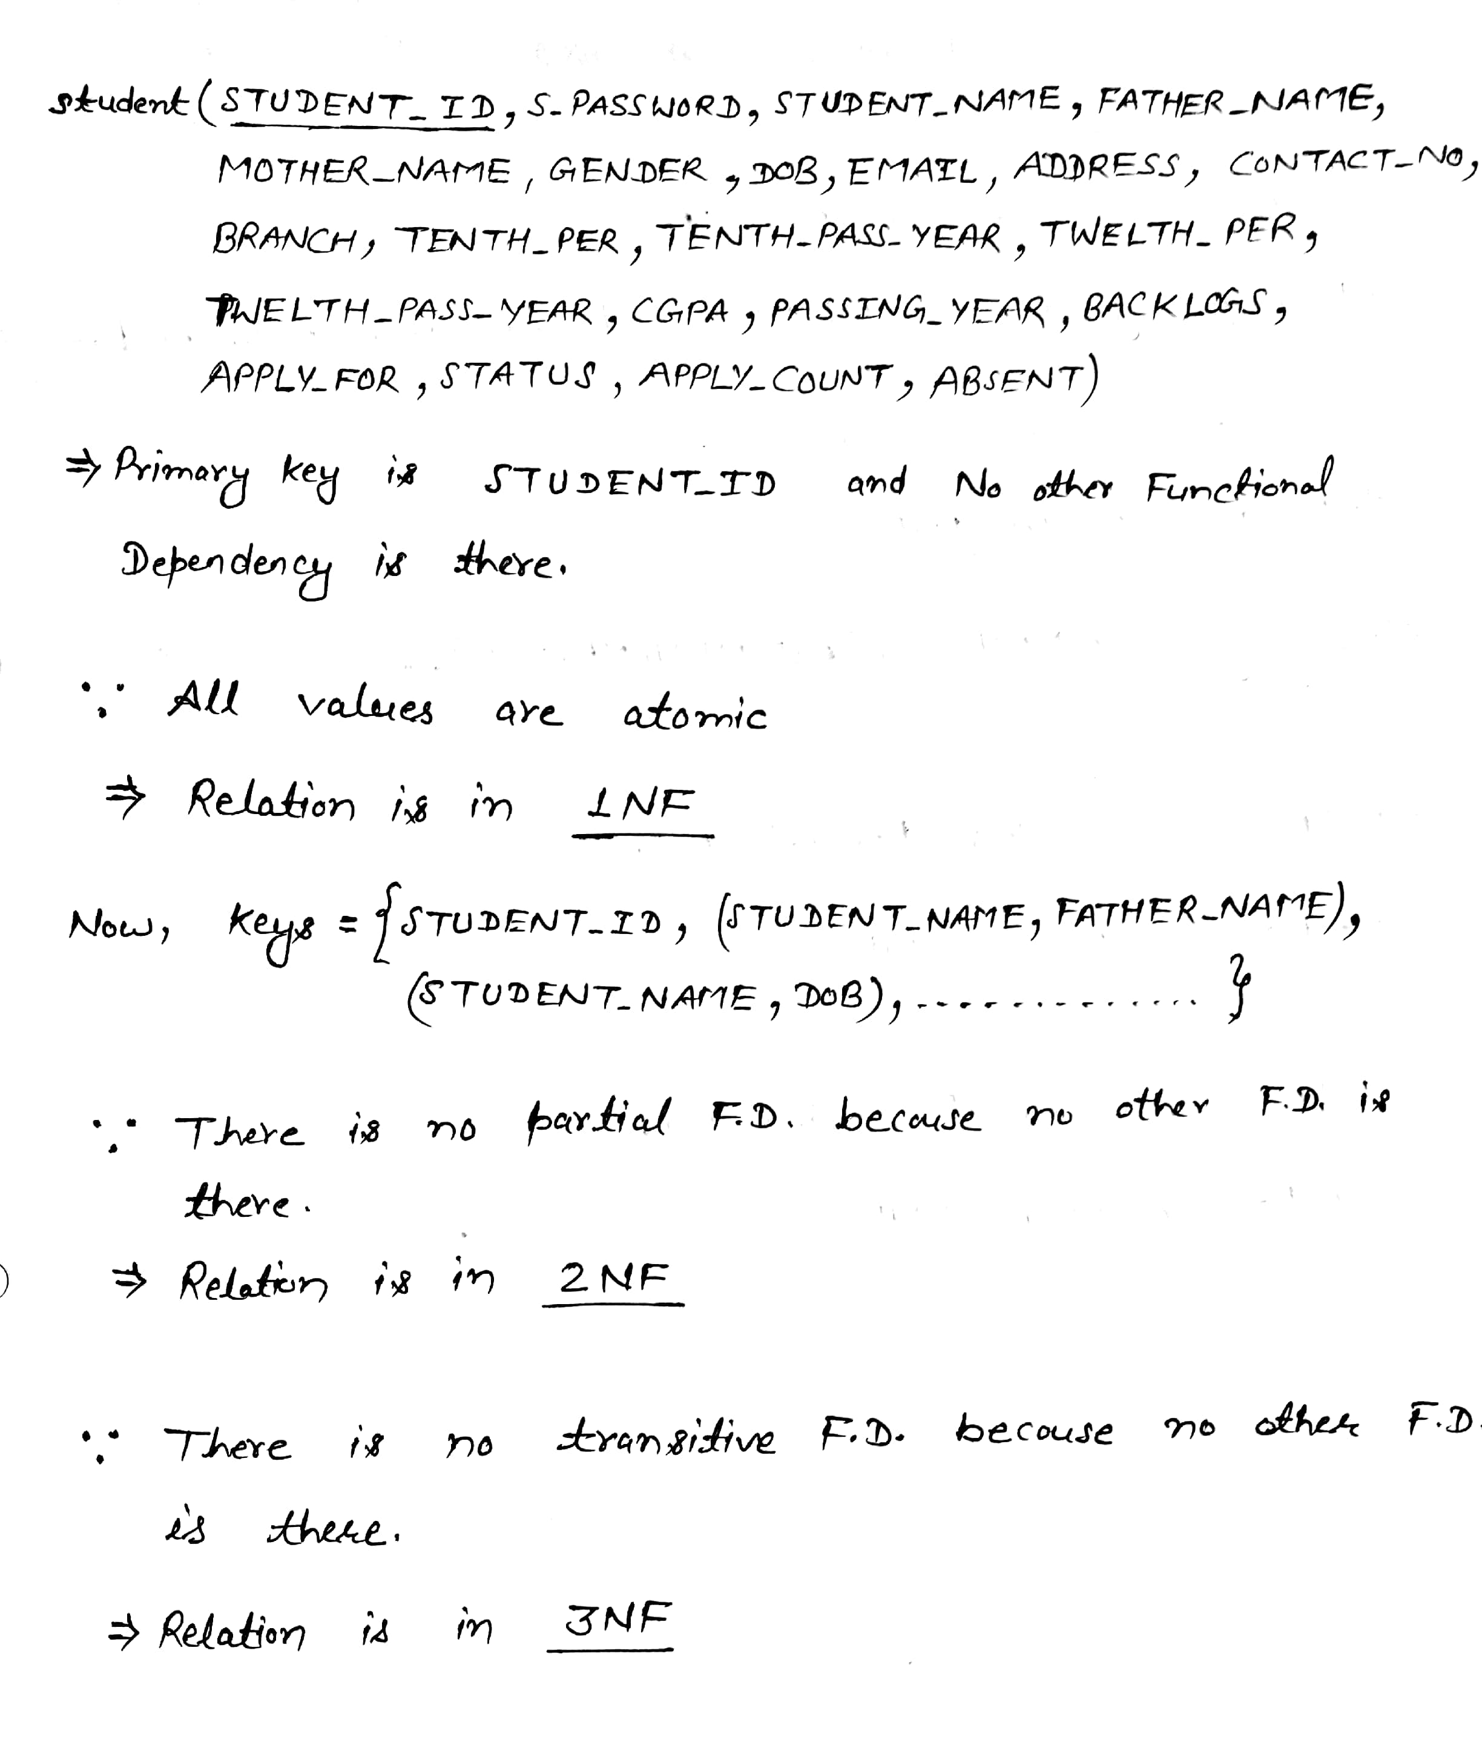
Normalization of Schemas

Slide 19
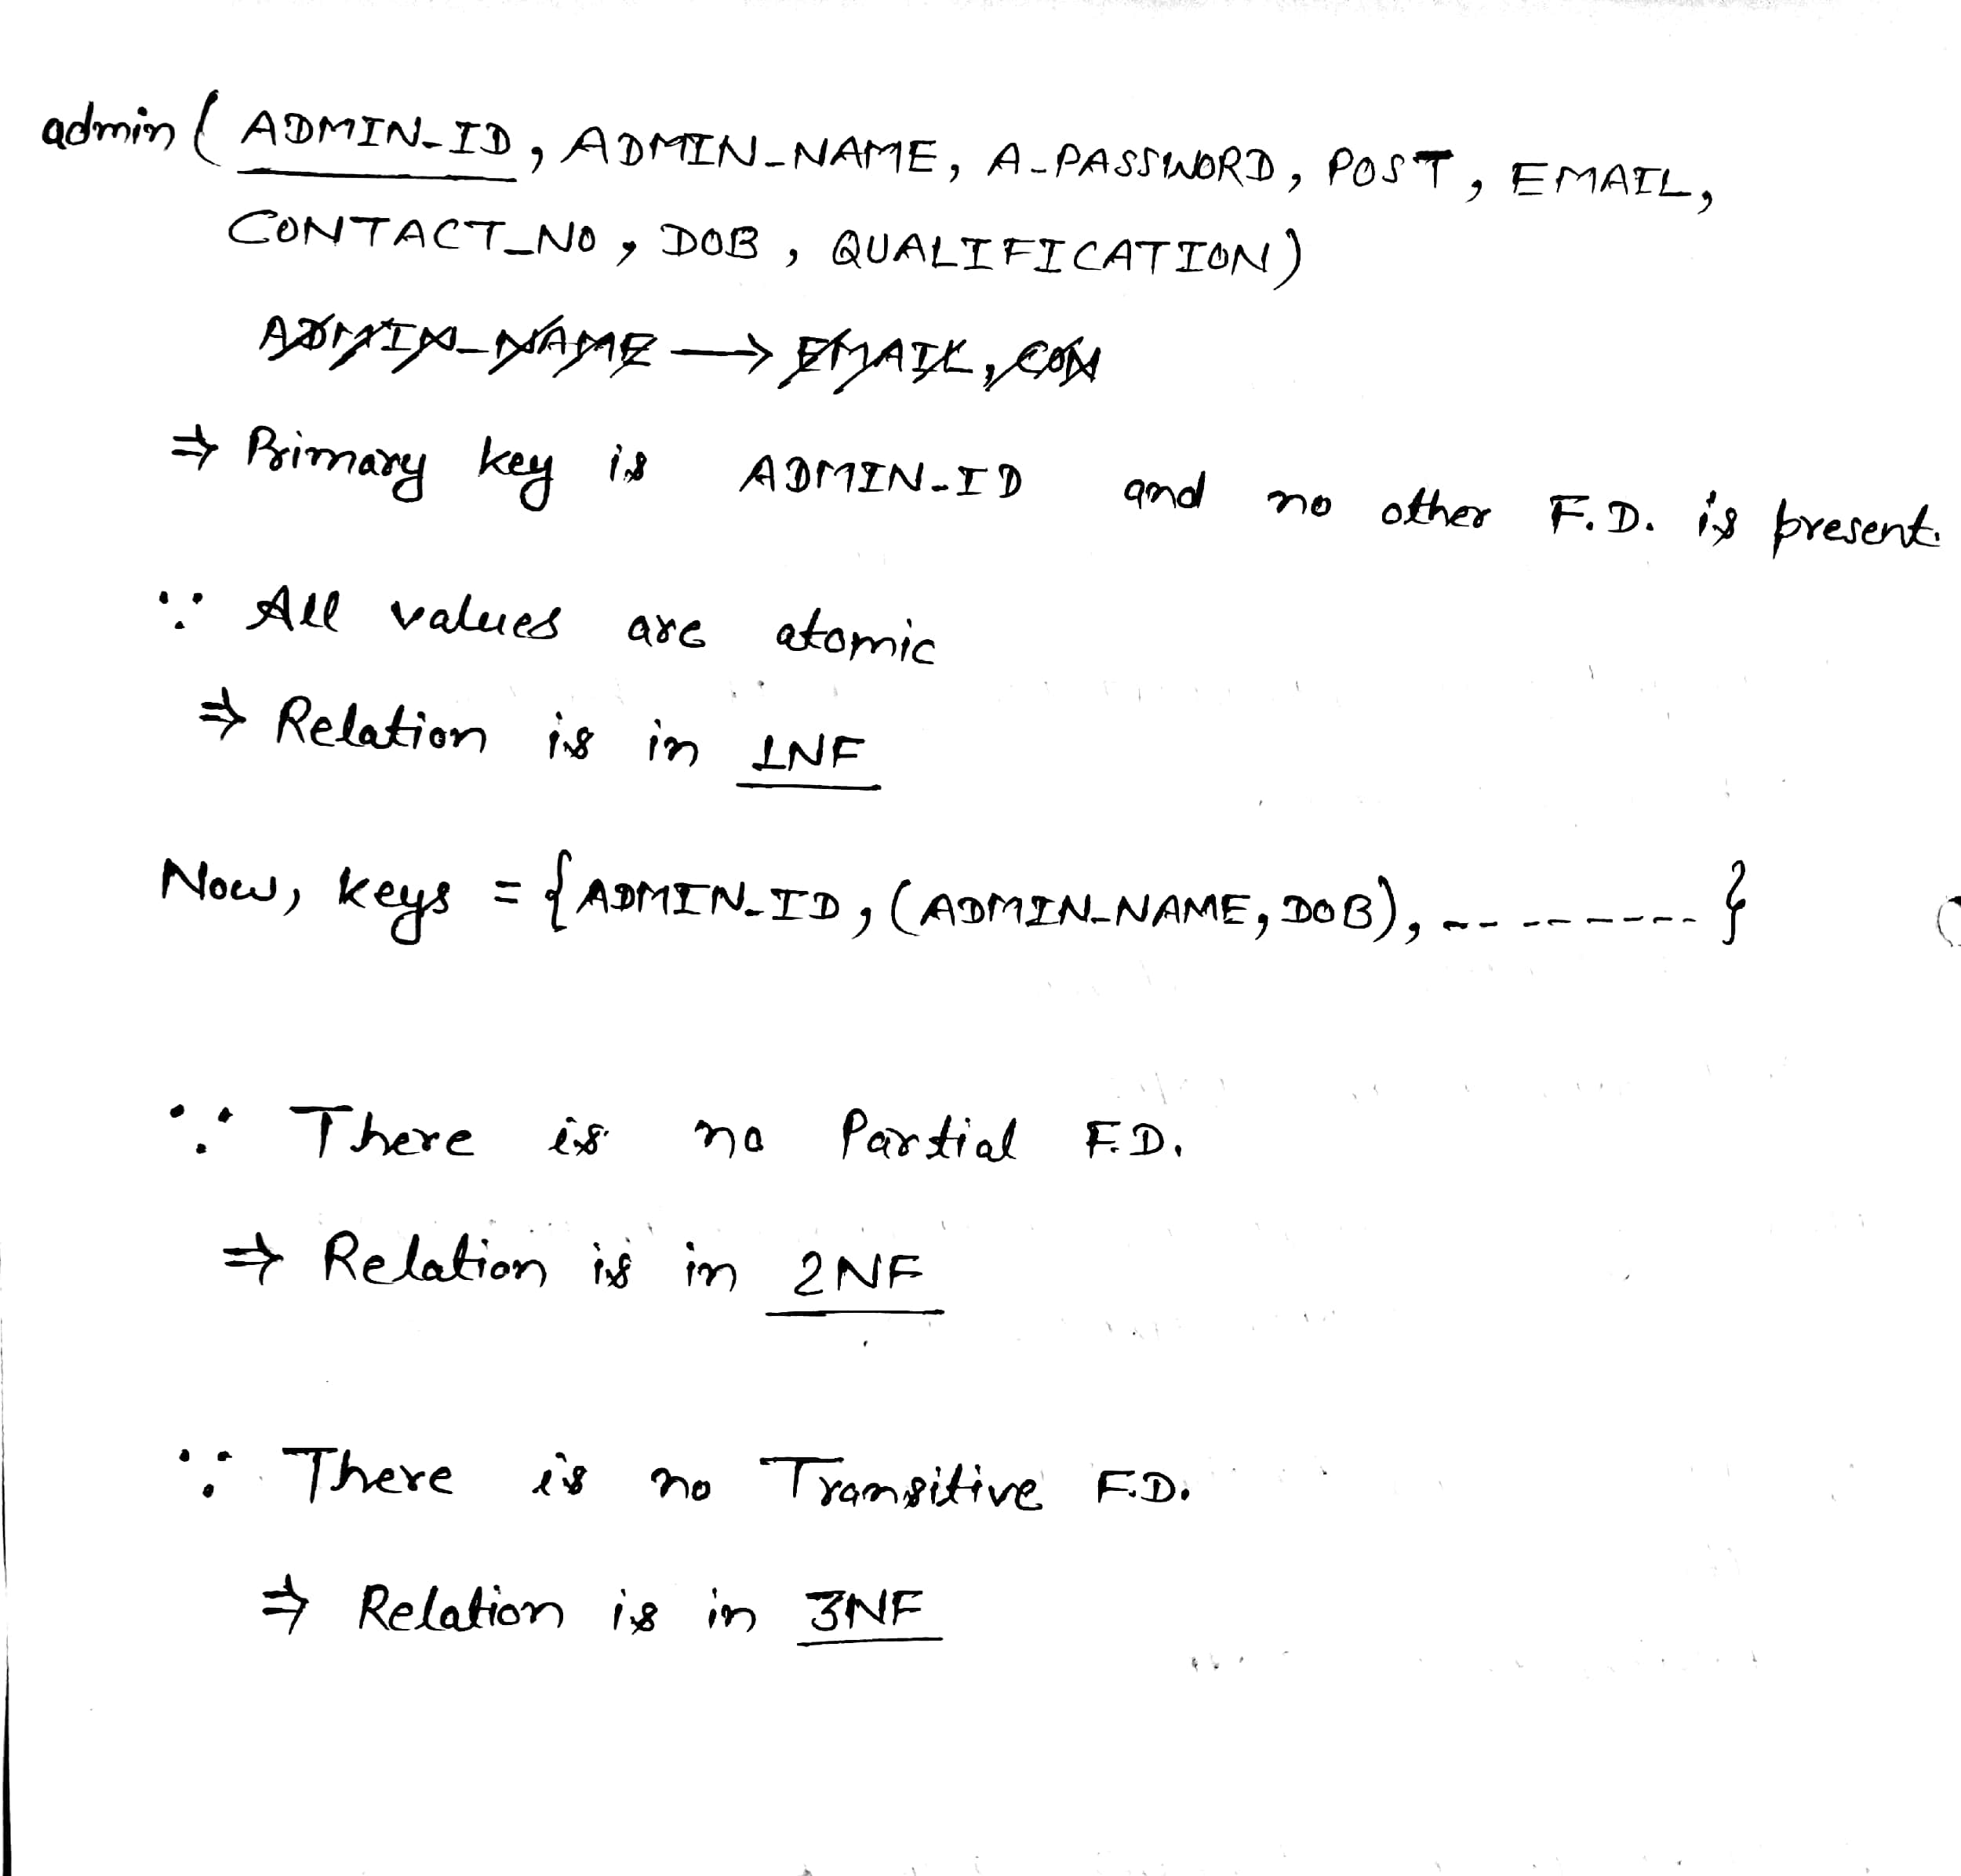

Slide 20
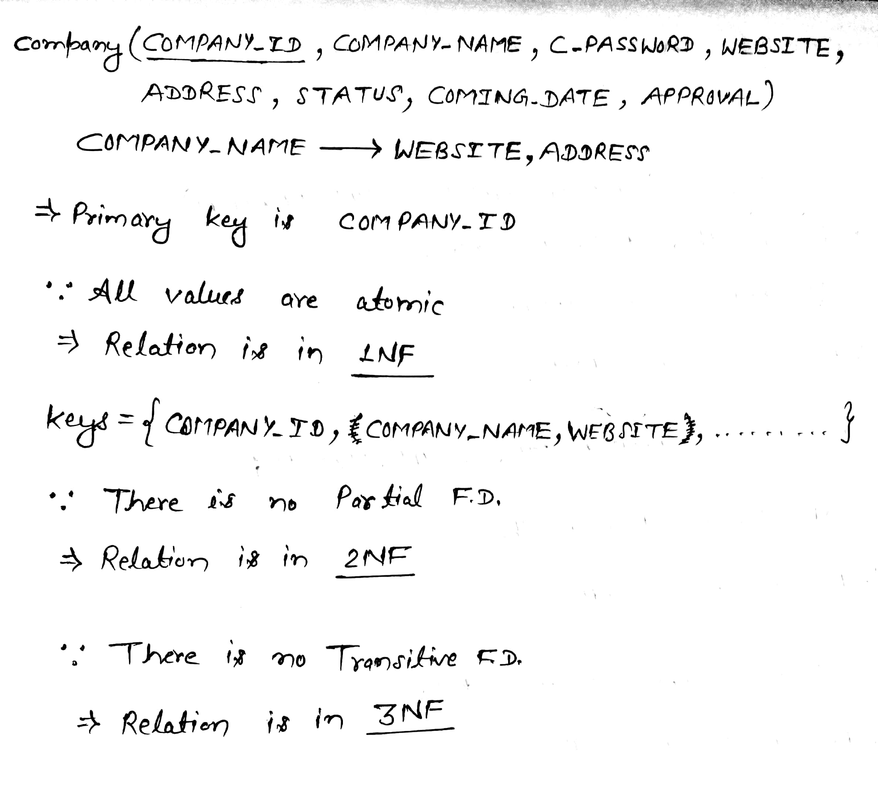

Slide 21
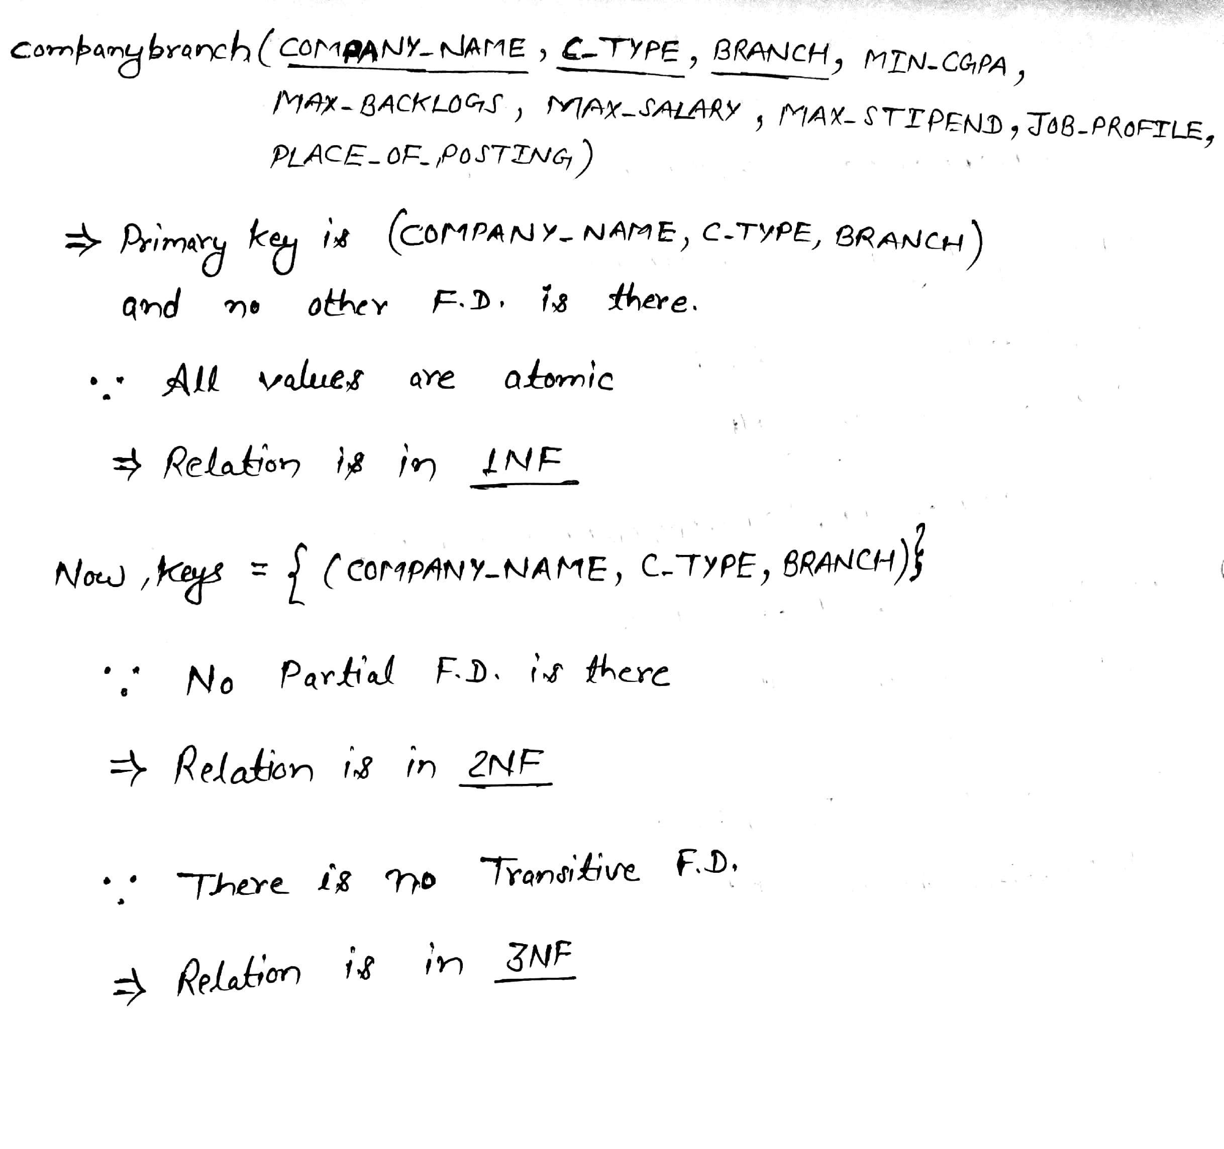

Slide 22
IMPLEMENTATION

Slide 23
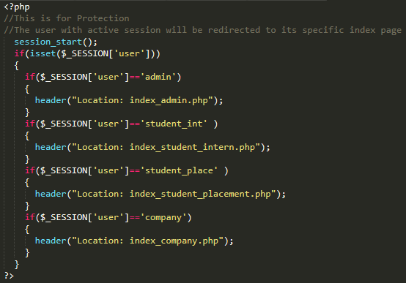
Session-protection
CODING

Slide 24
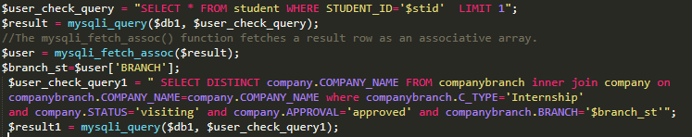
Companies with same branch that the students have are shown during apply for the company section.

Slide 25
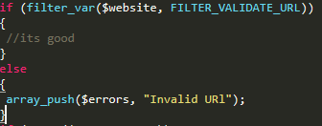
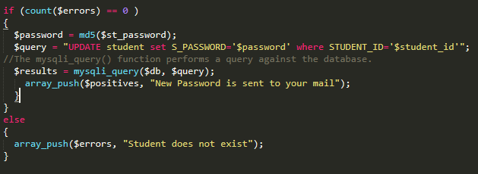
Various Constraints check, password encryption And Displaying error and Success message

Slide 26
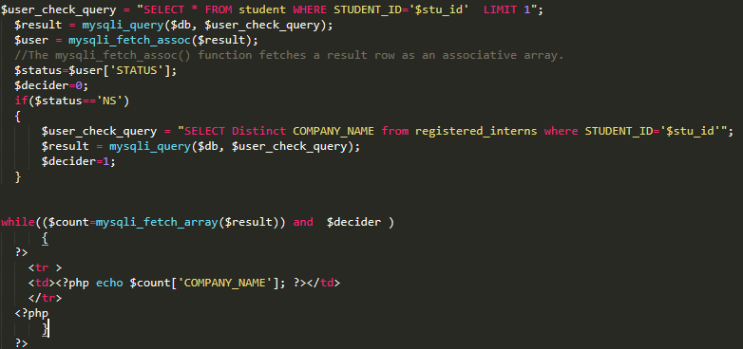
View registered company by student.

Slide 27
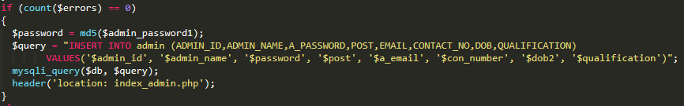
Insert Query

Slide 28
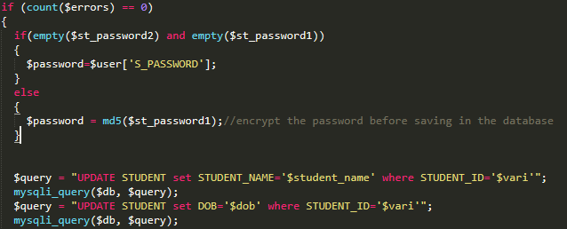
Update Query

Slide 29
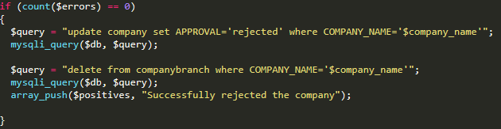
Delete Query

Slide 30
Glimpse of our site

Slide 31
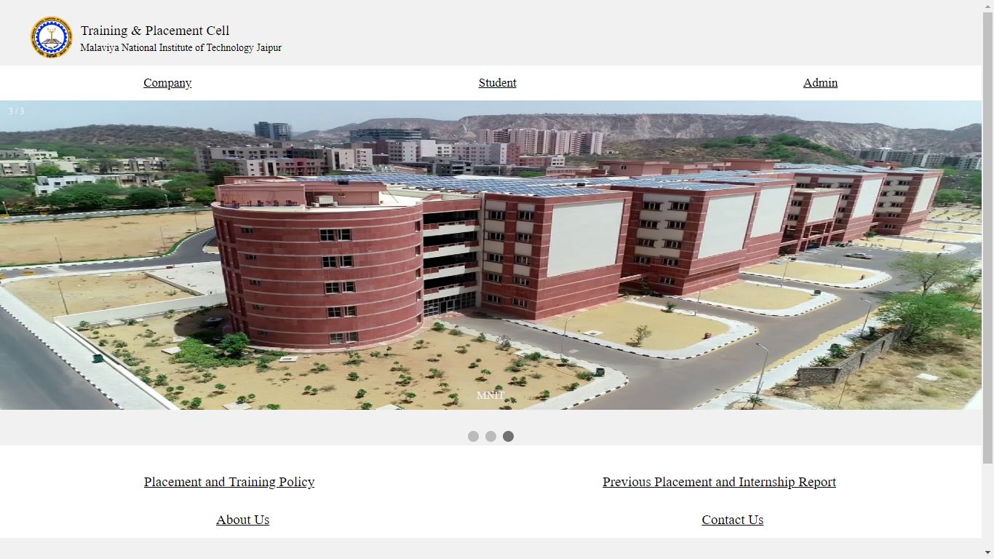

Slide 32
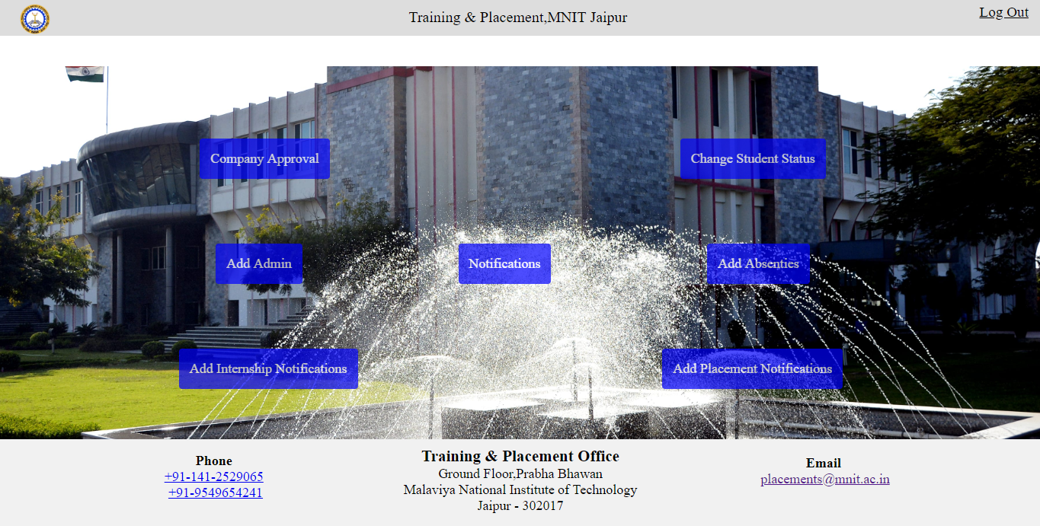

Slide 33
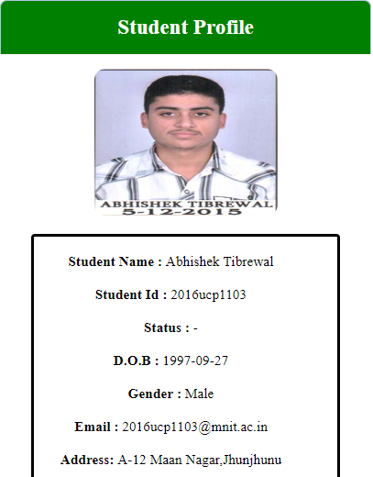
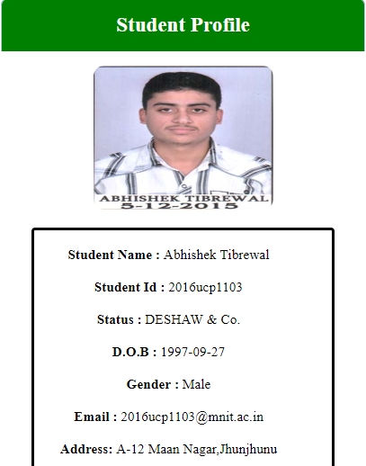
Before got Intern
After got Intern

Slide 34
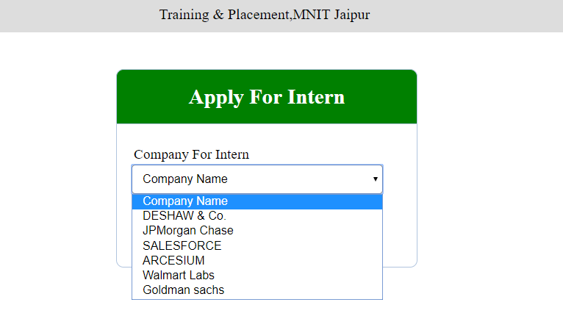
Dynamic Drop down list of Companies(Branch wise) for a student

Slide 35
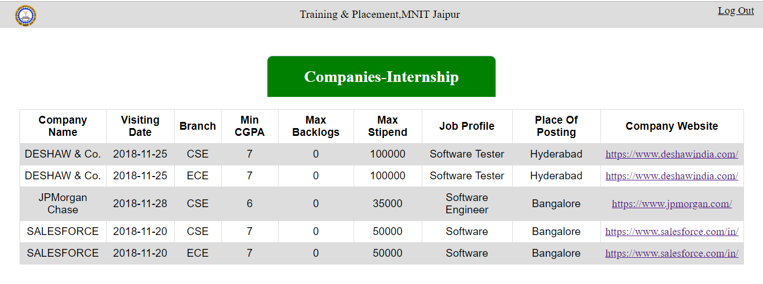
List of Visiting Companies for Internship

Slide 36
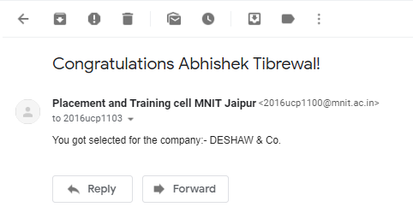
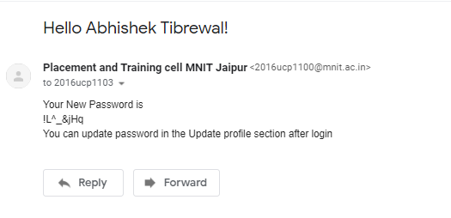
Mail Facility for better user experience and Authenticity.

Slide 37
Tools and technologies used:
Back-End: php with mysql( xampp server)
Front-End: html, css , javascript
Hardware Specification:
O.S.- windows
Browser that supports html, css, javascript.

Slide 38
REFERENCES
Websites:
http://www.w3schools.com
https://www.quora.com
http://stackoverflow.com
https://www.tutorialspoint.com
Books:
Database management system concepts by korth.

